Slide 1
NLP Convolutional Neural Network lecture 03.4
Branko Žitko

Slide 2
Convolving 2D stride 1
input (6x6)
filter/kernel (3x3)
output for stride 1 (4x4)
2 | 7 | 6 | 4 | 6 | 5
0 | 4 | 0 | 3 | 8 | 4
0 | 4 | 1 | 2 | 5 | 5
7 | 6 | 9 | 6 | 3 | 1
9 | 3 | 1 | 9 | 7 | 9
2 | 0 | 5 | 9 | 3 | 4
0 | 0 | 0
0 | 1 | 0
0 | 0 | 0
4 | 0 | 3 | 8
4 | 1 | 2 | 5
6 | 9 | 6 | 3
3 | 1 | 9 | 7
Calculating output size:
output width = ( input width – filter width ) / stride + 1
output height = ( input height – filter height ) / stride + 1

Slide 3
Convolving 2D stride 1
input (6x6)
filter/kernel (3x3)
output for stride 1 (4x4)
2 | 7 | 6 | 4 | 6 | 5
0 | 4 | 0 | 3 | 8 | 4
0 | 4 | 1 | 2 | 5 | 5
7 | 6 | 9 | 6 | 3 | 1
9 | 3 | 1 | 9 | 7 | 9
2 | 0 | 5 | 9 | 3 | 4
0 | 0 | 0
0 | 1 | 0
0 | 0 | 0
4 | 0 | 3 | 8
4 | 1 | 2 | 5
6 | 9 | 6 | 3
3 | 1 | 9 | 7
2 | 7 | 6
0 | 4 | 0
0 | 4 | 1
0 | 0 | 0
0 | 1 | 0
0 | 0 | 0
0 | 0 | 0
0 | 4 | 0
0 | 0 | 0
*
=
sum >
4

Slide 4
Convolving 2D stride 1
1
input (6x6)
filter/kernel (3x3)
output for stride 1 (4x4)
2 | 7 | 6 | 4 | 6 | 5
0 | 4 | 0 | 3 | 8 | 4
0 | 4 | 1 | 2 | 5 | 5
7 | 6 | 9 | 6 | 3 | 1
9 | 3 | 1 | 9 | 7 | 9
2 | 0 | 5 | 9 | 3 | 4
0 | 0 | 0
0 | 1 | 0
0 | 0 | 0
4 | 0 | 3 | 8
4 | 1 | 2 | 5
6 | 9 | 6 | 3
3 | 1 | 9 | 7
7 | 6 | 4
4 | 0 | 3
4 | 1 | 2
0 | 0 | 0
0 | 1 | 0
0 | 0 | 0
0 | 0 | 0
0 | 0 | 0
0 | 0 | 0
*
=
sum >
0

Slide 5
Convolving 2D stride 1
1
input (6x6)
filter/kernel (3x3)
output for stride 1 (4x4)
2 | 7 | 6 | 4 | 6 | 5
0 | 4 | 0 | 3 | 8 | 4
0 | 4 | 1 | 2 | 5 | 5
7 | 6 | 9 | 6 | 3 | 1
9 | 3 | 1 | 9 | 7 | 9
2 | 0 | 5 | 9 | 3 | 4
0 | 0 | 0
0 | 1 | 0
0 | 0 | 0
4 | 0 | 3 | 8
4 | 1 | 2 | 5
6 | 9 | 6 | 3
3 | 1 | 9 | 7
6 | 4 | 6
0 | 3 | 8
1 | 2 | 5
0 | 0 | 0
0 | 1 | 0
0 | 0 | 0
0 | 0 | 0
0 | 3 | 0
0 | 0 | 0
*
=
sum >
3

Slide 6
Convolving 2D stride 2
input (6x6)
filter/kernel (3x3)
output for stride 2 (2x2)
2 | 7 | 6 | 4 | 6 | 5
0 | 4 | 0 | 3 | 8 | 4
0 | 4 | 1 | 2 | 5 | 5
7 | 6 | 9 | 6 | 3 | 1
9 | 3 | 1 | 9 | 7 | 9
2 | 0 | 5 | 9 | 3 | 4
0 | 0 | 0
0 | 1 | 0
0 | 0 | 0
4 | 3
6 | 6
Calculating output size:
output width = ( input width – filter width ) / stride + 1
output height = ( input height – filter height ) / stride + 1

Slide 7
Convolving 2D stride 2
input (6x6)
filter/kernel (3x3)
output for stride 2 (2x2)
2 | 7 | 6 | 4 | 6 | 5
0 | 4 | 0 | 3 | 8 | 4
0 | 4 | 1 | 2 | 5 | 5
7 | 6 | 9 | 6 | 3 | 1
9 | 3 | 1 | 9 | 7 | 9
2 | 0 | 5 | 9 | 3 | 4
0 | 0 | 0
0 | 1 | 0
0 | 0 | 0
4 | 3
6 | 6
2 | 7 | 6
0 | 4 | 0
0 | 4 | 1
0 | 0 | 0
0 | 1 | 0
0 | 0 | 0
0 | 0 | 0
0 | 4 | 0
0 | 0 | 0
*
=
sum >
4

Slide 8
Convolving 2D stride 2
2
input (6x6)
filter/kernel (3x3)
output for stride 2 (2x2)
2 | 7 | 6 | 4 | 6 | 5
0 | 4 | 0 | 3 | 8 | 4
0 | 4 | 1 | 2 | 5 | 5
7 | 6 | 9 | 6 | 3 | 1
9 | 3 | 1 | 9 | 7 | 9
2 | 0 | 5 | 9 | 3 | 4
0 | 0 | 0
0 | 1 | 0
0 | 0 | 0
4 | 3
6 | 6
6 | 4 | 6
0 | 3 | 8
1 | 2 | 5
0 | 0 | 0
0 | 1 | 0
0 | 0 | 0
0 | 0 | 0
0 | 3 | 0
0 | 0 | 0
*
=
sum >
3

Slide 9
Convolving 2D stride 2
input (6x6)
filter/kernel (3x3)
output for stride 2 (2x2)
2 | 7 | 6 | 4 | 6 | 5
0 | 4 | 0 | 3 | 8 | 4
0 | 4 | 1 | 2 | 5 | 5
7 | 6 | 9 | 6 | 3 | 1
9 | 3 | 1 | 9 | 7 | 9
2 | 0 | 5 | 9 | 3 | 4
0 | 0 | 0
0 | 1 | 0
0 | 0 | 0
4 | 3
6 | 6
2
0 | 4 | 1
7 | 6 | 9
9 | 3 | 1
0 | 0 | 0
0 | 1 | 0
0 | 0 | 0
0 | 0 | 0
0 | 6 | 0
0 | 0 | 0
*
=
sum >
6

Slide 10
Feed-Forward Networks
One of the historic downfalls of the perceptron was that it cannot learn modestly nontrivial patterns present in data.
Feed-Forward Networks
Multilayer perceptron (MLP)
Convolutional neural network (CNN)
MLP extends the simple perceptron
by grouping many perceptrons in a single layer and
stacking multiple layers together

Slide 11
Convolving 2D stride 2
input (1x2x4x4)
filter/kernel (4x2x3x3)
output for stride 1 (1x4x2x2)
N x iC x iH x iW
oC x iC x kH x kW
N x oC x cH x cW
5 | 5 | 7 | 6
9 | 6 | 3 | 1
9 | 3 | 1 | 9
7 | 9 | 2 | 0
0 | 1 | 0
0 | 0 | 0
0 | 0 | 0
7 | 14
12 | 8
1 | 0 | 0
0 | 0 | 0
0 | 0 | 0
2 | 7 | 6 | 4
6 | 5 | 0 | 4
0 | 3 | 8 | 4
0 | 4 | 1 | 2
0 | 0 | 0
1 | 0 | 0
0 | 0 | 0
15 | 10
9 | 7
0 | 0 | 1
0 | 0 | 0
0 | 0 | 0
0 | 0 | 0
0 | 0 | 1
0 | 0 | 0
8 | 1
4 | 17
0 | 0 | 0
0 | 1 | 0
0 | 0 | 0
0 | 0 | 0
0 | 0 | 0
0 | 1 | 0
3 | 4
9 | 6
0 | 0 | 0
0 | 0 | 0
1 | 0 | 0

Slide 12
The Multilayer Perceptron
The multilayer perceptron is considered one of the most basic neural network building blocks.
The simplest MLP is an extension to the perceptron.
The perceptron takes the data vector as input and computes a single output value.
In an MLP, many perceptrons are grouped so that the output of a single layer is a new vector instead of a single output value

Slide 13
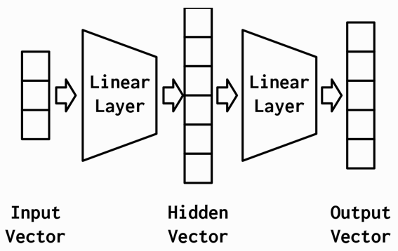
The Multilayer Perceptron
The simplest MLP is composed of
three stages of representation and
two Linear layers
The First stage is the input vector
The First linear layer computes a hidden vector
The Second stage is that hidden vector
The Second linear layer computes an output vector

Slide 14
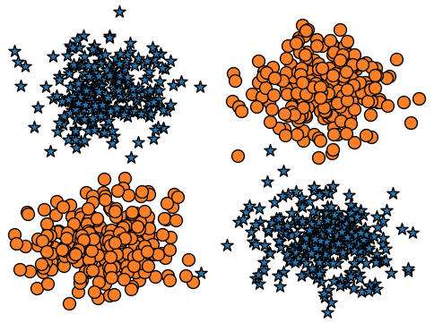
A Simple Example: XOR
Two classes in the XOR dataset plotted as circles and stars.
Perceptron
MLP

Slide 15
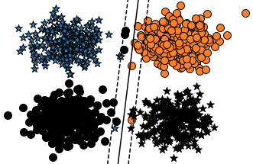
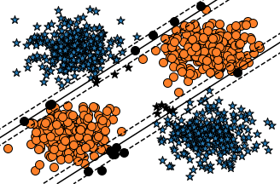
A Simple Example: XOR
The decision boundary cannot be a single straight line (linearly separable)
It appears that the MLP has two decision boundaries, and that is its advantage, it is actually just one decision boundary!
The decision boundary just appears that way because the intermediate representation has morphed the space to allow one hyperplane to appear in both of those positions.
Perceptron
MLP

Slide 16
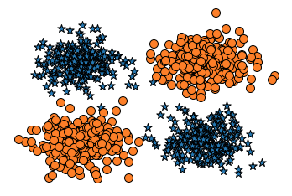
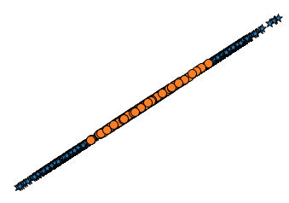
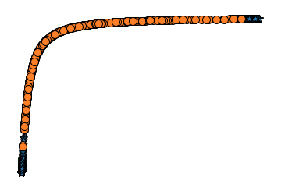
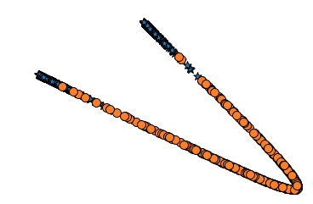
A Simple Example: XOR
MLP has learned to “warp” the space in which the data lives so that it can divide the dataset with a single line by the time it passes through the final layer.
1. input to the nework
2. output of the first linear module
3. output of the first nonlinearity
4. output of the second linear module

Slide 17
The Multilayer Perceptron
Because of the sequential nature of the layers, you must take care to ensure that the number of outputs in a layer is equal to the number of inputs to the next layer. ModuleList will be list of input and hidden layers fully connected layer is at the end last_forward_cache will be used to store layer's output
import torch class MultilayerPerceptron(torch.nn.Module): def __init__(self, input_size, hidden_size=2, output_size=3, num_hidden_layers=1, hidden_activation=torch.nn.Sigmoid): super(MultilayerPerceptron, self).__init__() self.module_list = torch.nn.ModuleList() # (1) interim_input_size = input_size interim_output_size = hidden_size for _ in range(num_hidden_layers): self.module_list.append(torch.nn.Linear(interim_input_size, interim_output_size)) self.module_list.append(hidden_activation()) interim_input_size = interim_output_size self.fc_final = torch.nn.Linear(interim_input_size, output_size) # (2) self.last_forward_cache = [] # (3)

Slide 18
The Multilayer Perceptron
Because of the sequential nature of the layers, you must take care to ensure that the number of outputs in a layer is equal to the number of inputs to the next layer. store input data store outputs of first n – 1 layers store outputs of final layer apply softmax
def forward(self, x, apply_softmax=False): self.last_forward_cache = [] self.last_forward_cache.append(x.to("cpu").numpy()) # (1) for module in self.module_list: x = module(x) # (2) self.last_forward_cache.append(x.to("cpu").data.numpy()) output = self.fc_final(x) self.last_forward_cache.append(output.to("cpu").data.numpy()) # (3) if apply_softmax: output = F.softmax(output, dim=1) # (4) return output

Slide 19
The Multilayer Perceptron
Multilayer perceptron with 1 hidden layer
mlp = MultilayerPerceptron(input_size=2, hidden_size=2, num_hidden_layers=1, output_size=2) mlp
MultilayerPerceptron( (module_list): ModuleList( (0): Linear(in_features=2, out_features=2, bias=True) (1): Sigmoid() ) (fc_final): Linear(in_features=2, out_features=2, bias=True) )

